Slide 1
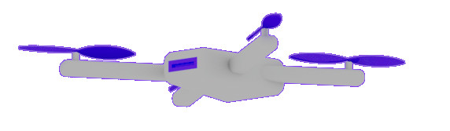
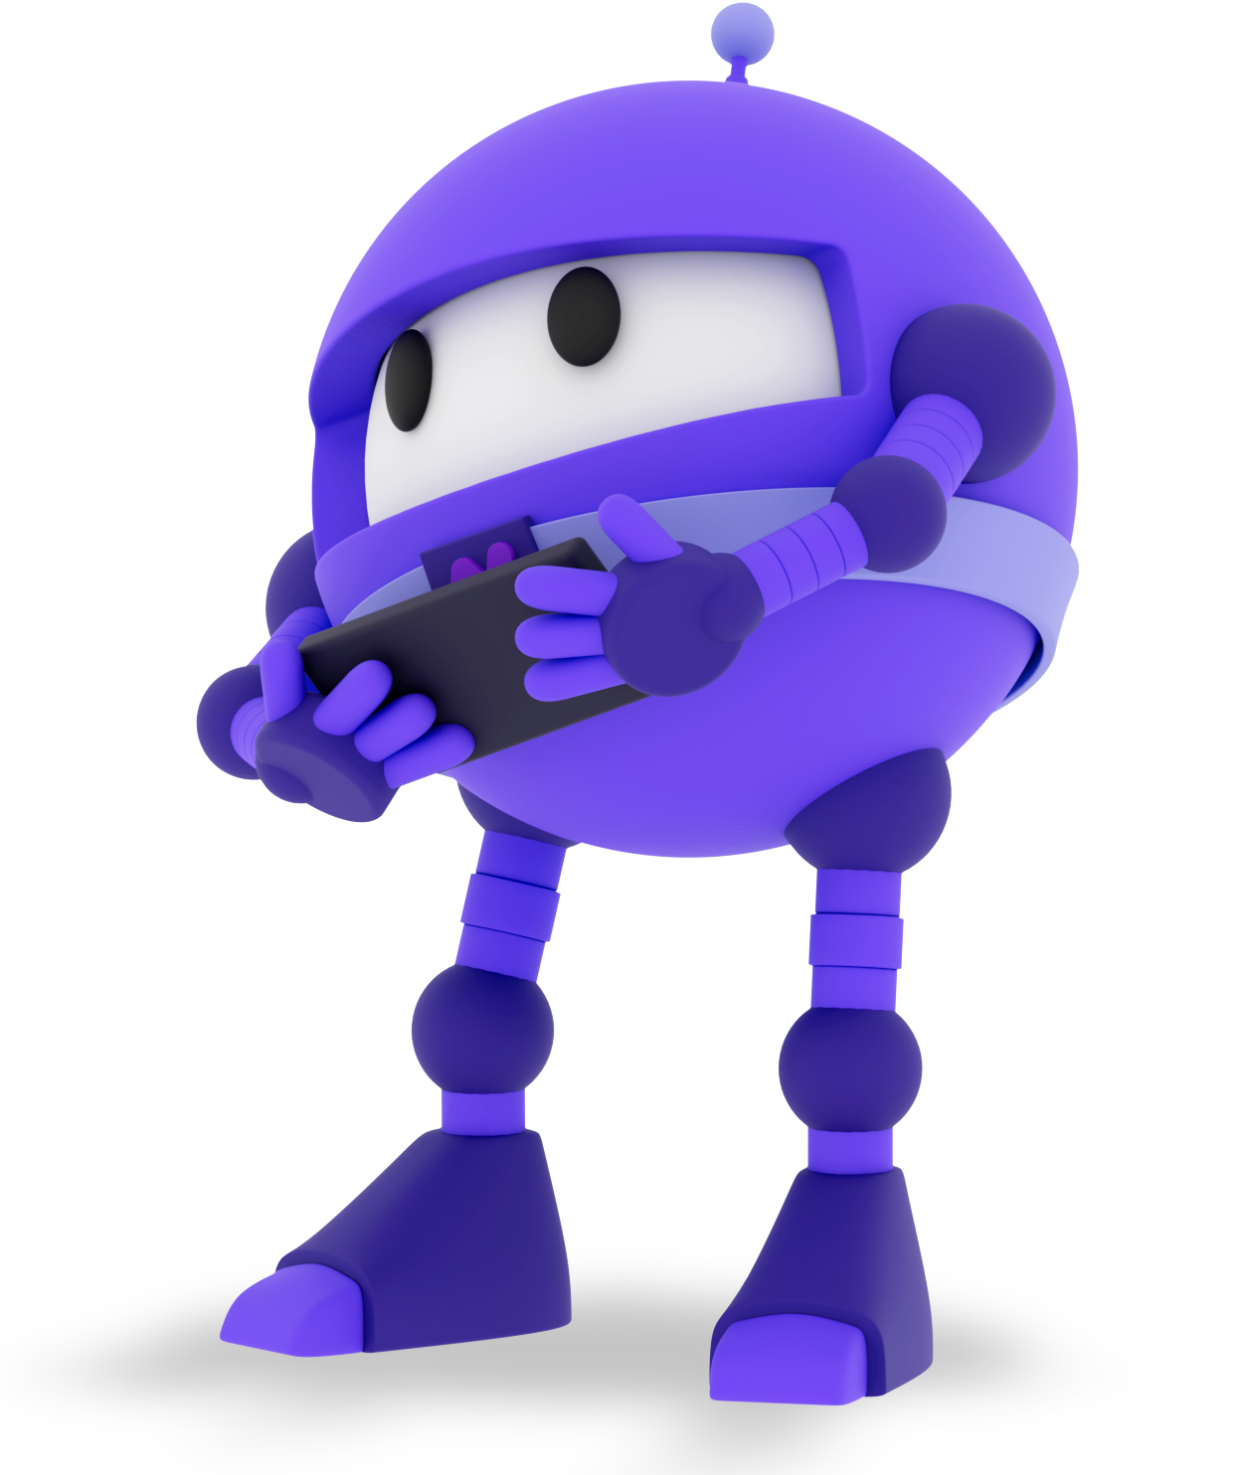
.NET Conf 2022
Focus on MAUI
November 8-10
Focus.dotnetconf.net

Slide 2
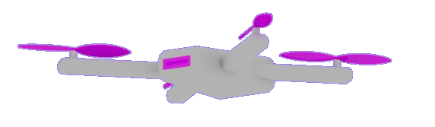
.NET Conf 2022
Focus on MAUI
November 8-10
Focus.dotnetconf.net

Slide 3
Welcome

Slide 4
Presenter Name
Presenter Title

Slide 6
Tips for a better presentation
01
02
03
04
05
06
Consider keeping your content limited to what fits comfortably on a slide, use another slide if you run out of space.
Make sure to change the “Team name” within the Master Slides of the template, this will change all of the slides.
When pasting content, use the Paste options to preserve the destination template characteristics.
You can always reset a slide by right-clicking on the thumbnail and selecting “Reset slide”
Make sure the margins are always kept without any information or graphics. This clear space around the slide makes it look professional.
Do not overwrite this template. Download a copy and make it yours.

Slide 7
Adoption of .NET
1.7x
126%
>5M total
Notes:
[M] Like David said, .NET MAUI is just part of .NET – and .NET is growing! In fact, .NET 6 was adopted at nearly twice the rate of .NET 5, and .NET 7 comes out this November! Even with tooling in preview, we have seen HUGE usage and growth of MAUI since we released the SDK, and we are super grateful for all of the apps and blogs and videos and feedback you’ve shipped so far.

Slide 8
>1B
>4B
Windows 10 & 11 devices worldwide
iPhone & Android devices worldwide
Sources: blog.google/products/android/android-12-beta/ ; www.imore.com/apple-earnings-call-transcripts-q1-2021 ;

Slide 9
Large centered headline
Subtitle

Slide 10
Images

Slide 11
Images

Slide 14
Section title

Slide 16
Table title

Slide 17
Add a title

Slide 18
Add a title

Slide 20
Chart design
65%
Value

Slide 21
Chart design

Slide 22
170K+
87K+
19.2M
Value
Value
Value
1.5M
436K
1.9M
Value
Value
Value

Slide 23
.NET MAUI perf improvements
68%
Faster than Xamarin.Android
44%
Faster than Xamarin.Forms
Notes:
[M] MAUI is also super fast. If you’re coming from Xamarin, you’re going to see huge performance improvements in your app startup and more. If you’re new to cross platform .NET development, you’ll be amazed at just how speedy it is!

Slide 24
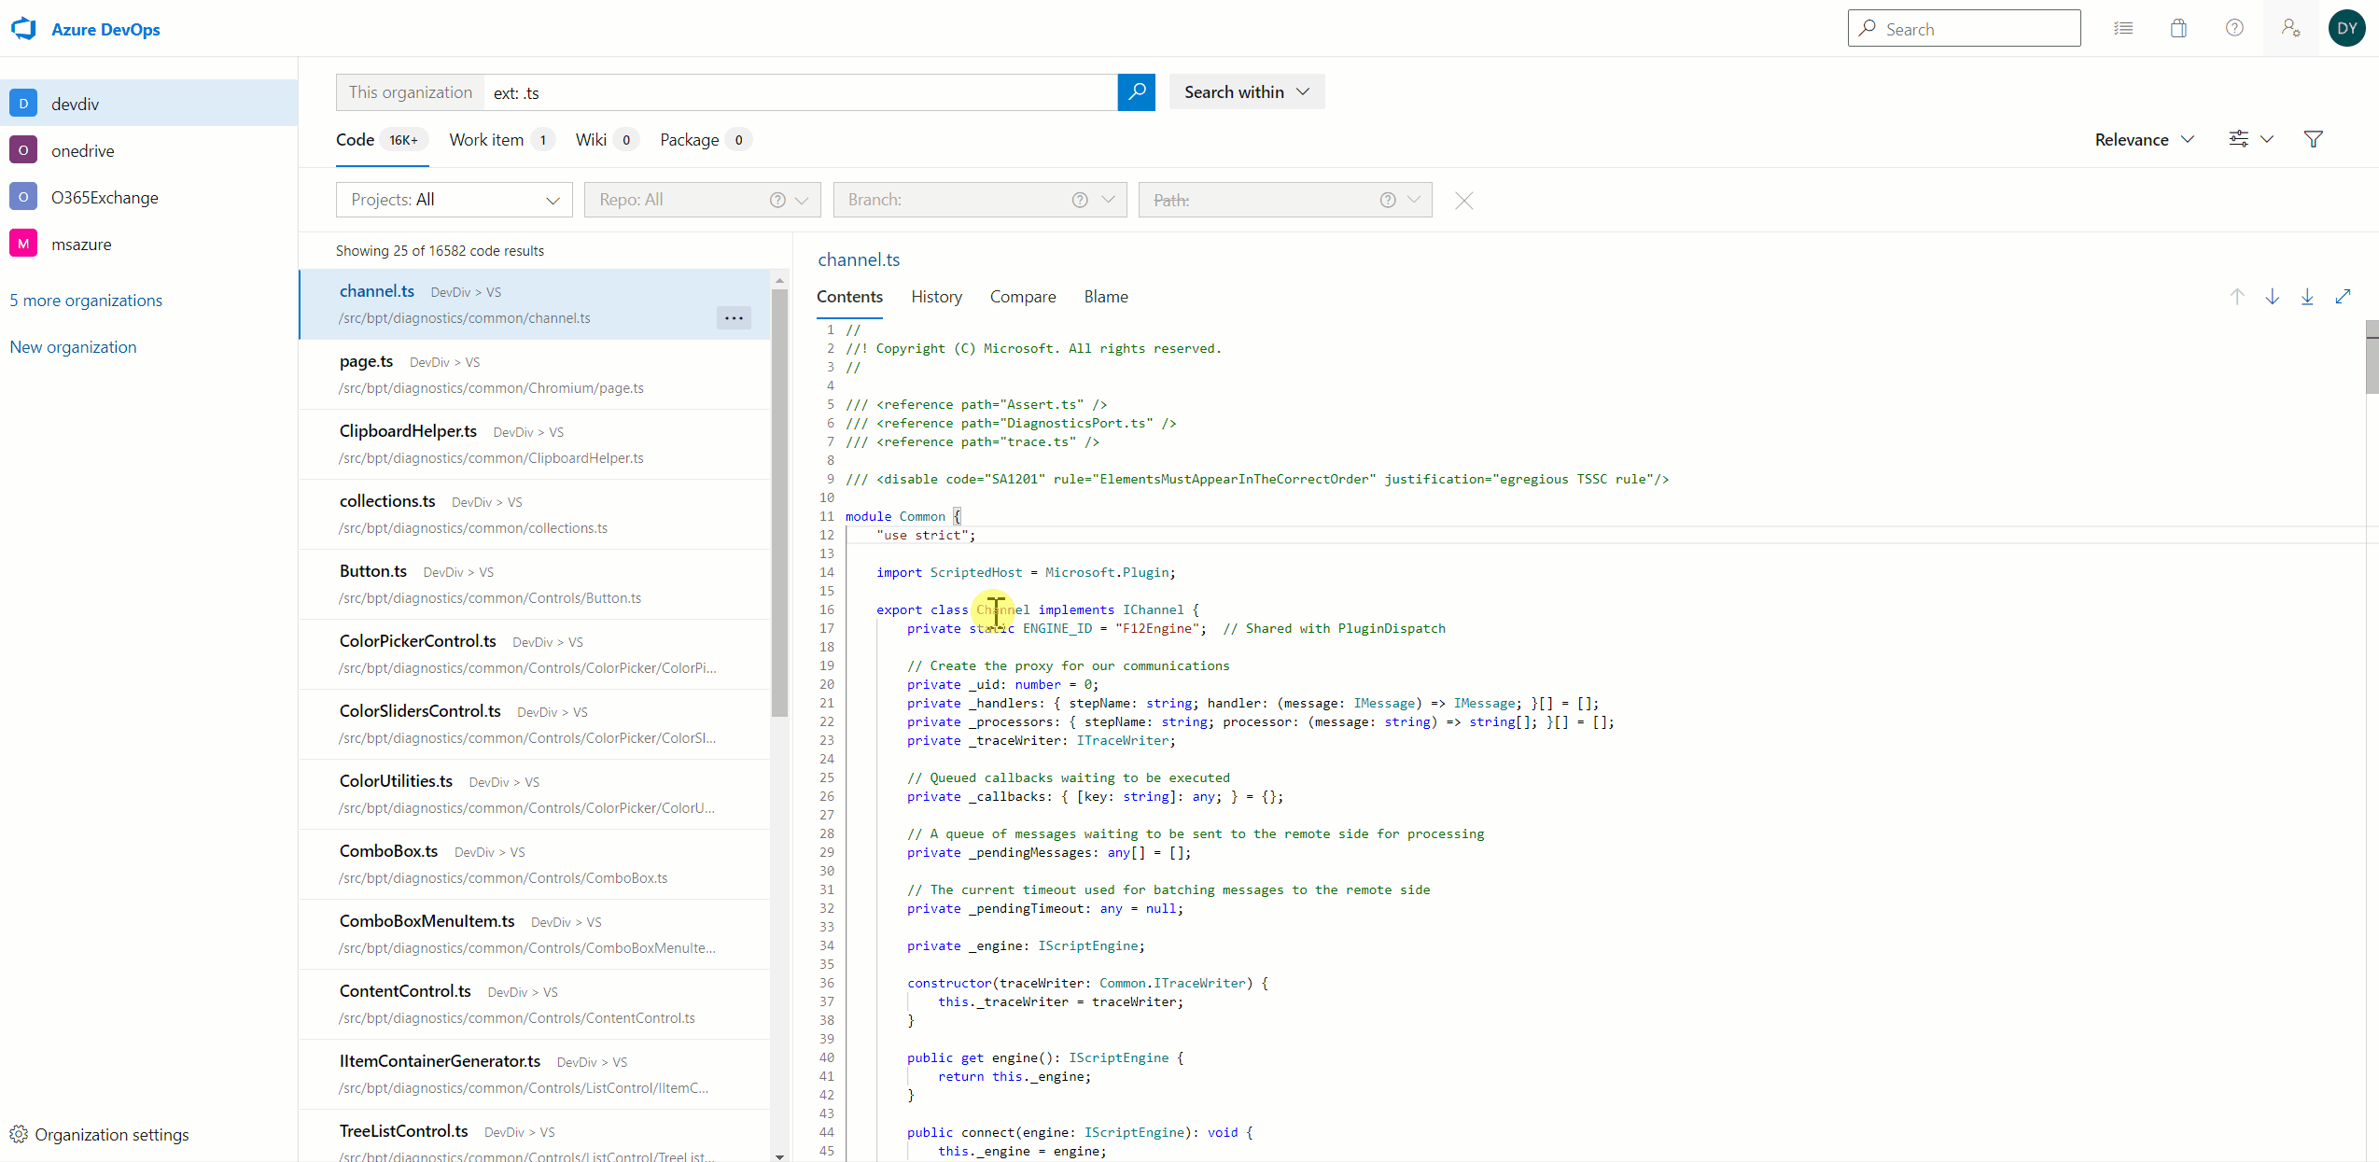
Demo example
Subtitle

Slide 25
Demo example
Subtitle

Slide 26

Notes:
A HUGE thank you everyone who made these incredible contributions to the .NET MAUI ecosystem!
<pause and clap your hands>

Slide 27

Notes:
A HUGE thank you everyone who made these incredible contributions to the .NET MAUI ecosystem!
<pause and clap your hands>

Slide 28
Thank you!

Slide 29















































Icons for use

Slide 30







































Icons for use

Slide 31















Icons for use

Slide 32















































Icons for use

Slide 33







































Icons for use

Slide 34















Icons for use

